Slide 1

Note: The data and information in this document is reflective of a hypothetical situation and client. This document is to be used for KPMG Virtual Internship purposes only.
Sprocket Central Pty Ltd
Data analytics approach
Virtual Intern Lokman Efe

Slide 2
Note: The data and information in this document is reflective of a hypothetical situation and client. This document is to be used for KPMG Virtual Internship purposes only.
Agenda
Introduction
Data Exploration
Model Development
Interpretation

Slide 3
Note: The data and information in this document is reflective of a hypothetical situation and client. This document is to be used for KPMG Virtual Internship purposes only.
Introduction
Problem:
Sprocket Central is a company that specializes in high-quality bikes and cycling accessories.
Their marketing team is looking to boost business sales by analyzing provided data sets.
Task:
Identify and recommend 1000 new customers should be targeted to drive the most value for the organisation.

Slide 4
Note: The data and information in this document is reflective of a hypothetical situation and client. This document is to be used for KPMG Virtual Internship purposes only.
Data Exploration
Data Quality Assessment
Summary Table
Key issues for the Data Quality Assessment
Accuracy: Correct values
Completeness: Data fields with values
Consistency: Values free from contradiction
Currency: Values up to date
Relevancy: Data items with value meta-data
Validity: Data containing allowable values
Uniqueness: Records that are duplicated
 | Customer Demographic | Customer Address | Transactions
Accuracy | X |  | X
Completeness | X | X | X
Consistency | X | X
Currency | X
Relevancy | X |  | X
Validity |  |  | X

Slide 5
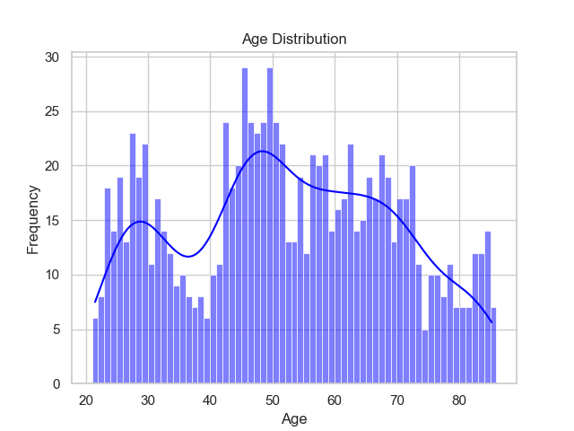
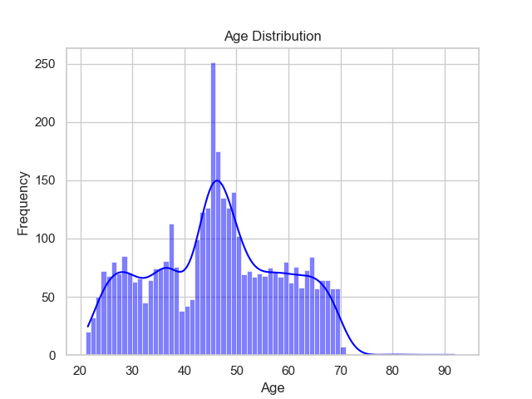
Note: The data and information in this document is reflective of a hypothetical situation and client. This document is to be used for KPMG Virtual Internship purposes only.
Data Exploration
‘New’ and ‘Old’ Customer Age Distributions
Most customers are aged between 40-50 in ‘New’ and ‘Old’.
The lowest age groups are 20- and 80+ for both ‘New’ and ‘Old’.
The ‘New’ customer list has a drop in the 30-40 group.
New
Old

Slide 6
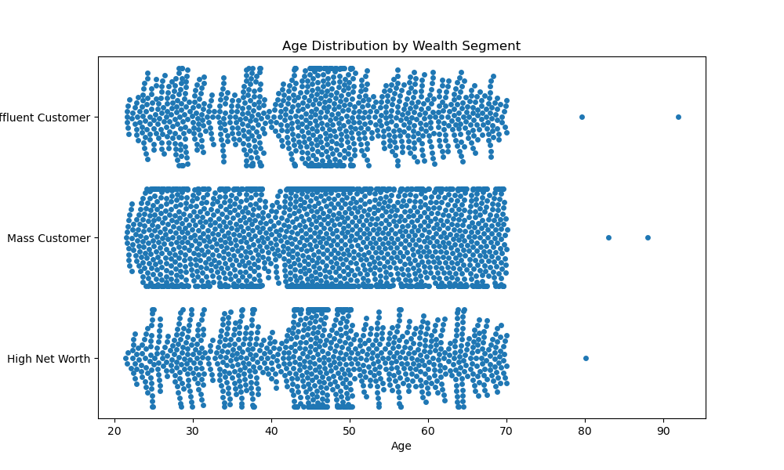
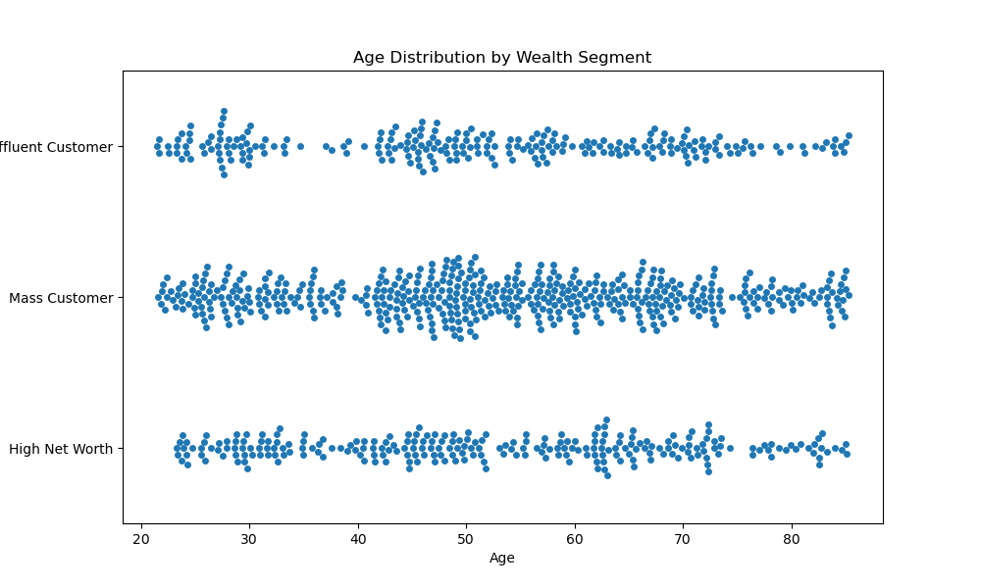
Note: The data and information in this document is reflective of a hypothetical situation and client. This document is to be used for KPMG Virtual Internship purposes only.
Data Exploration
Wealth segmentation by age
Old
In all age categories the largest number of customers are classified as ‘Mass Customer’
The next one is ‘High Net Worth’ customers.
Both ‘Old’ and ‘New’ has a drop at near 40 for Age.
New

Slide 7
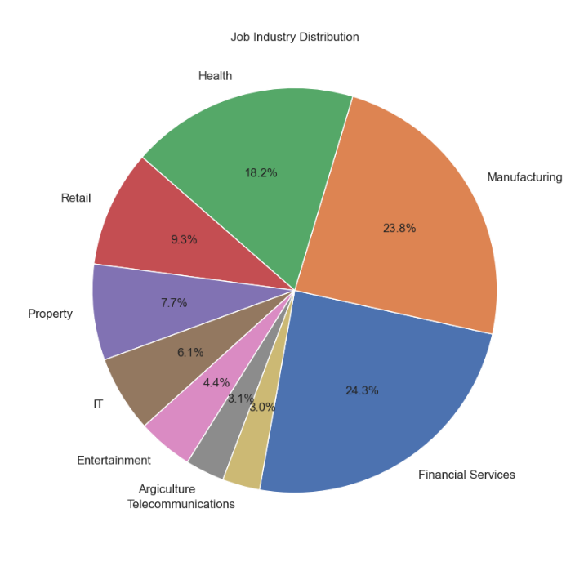
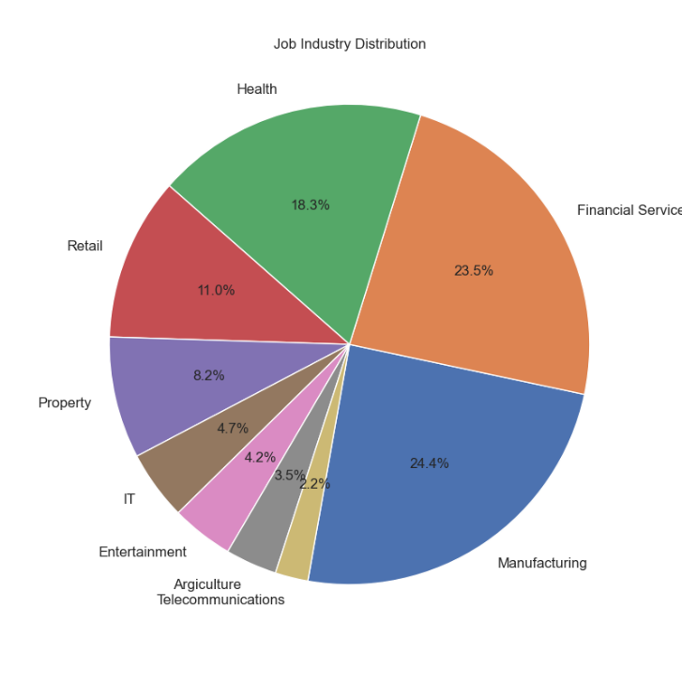
Note: The data and information in this document is reflective of a hypothetical situation and client. This document is to be used for KPMG Virtual Internship purposes only.
Data Exploration
Job Industry Distribution
New
Old
The smallest number of customers are in Agriculture and Telecommunications at 3%.
Nearly 24% of customers are in Manufacturing and Financial Services both in ‘New’ and ‘Old’.

Slide 8
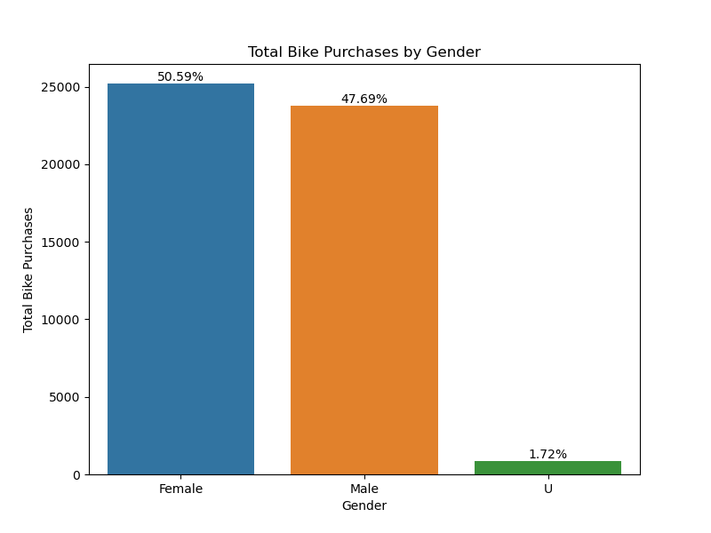
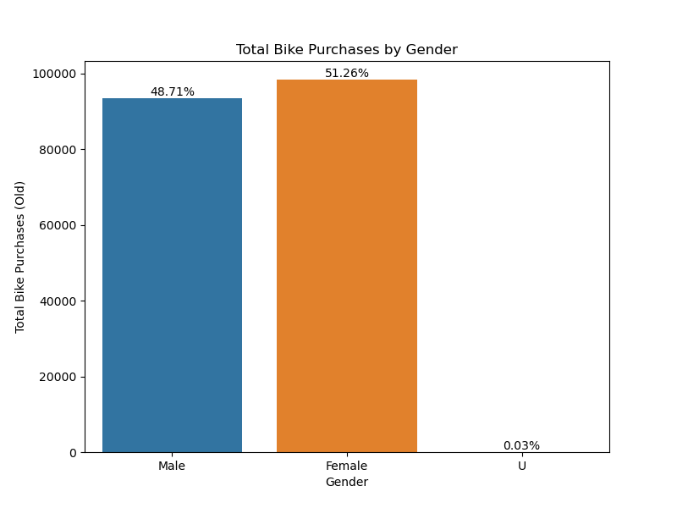
Note: The data and information in this document is reflective of a hypothetical situation and client. This document is to be used for KPMG Virtual Internship purposes only.
Data Exploration
Bike related purchases over last 3 years by gender
Females make up the majority for bike related sales.
Over the last three years, about 50% of bike related purchases were made by females to 48% of purchases made by males. Approximately 2% were made by ‘U’ gender.
New
Old

Slide 9
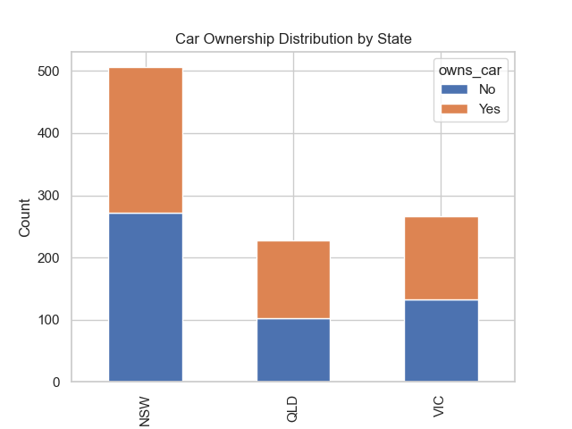
Note: The data and information in this document is reflective of a hypothetical situation and client. This document is to be used for KPMG Virtual Internship purposes only.
Data Exploration
Number of cars owned and not owned by state
NSW has the largest amount of people that do not own a car. NSW seems to have a higher number of people from which data was collected.
Victoria is also split quite evenly. But both numbers are significanly lower than those of NSW.
QLD has a relatively high number of customers that own a car.

Slide 10
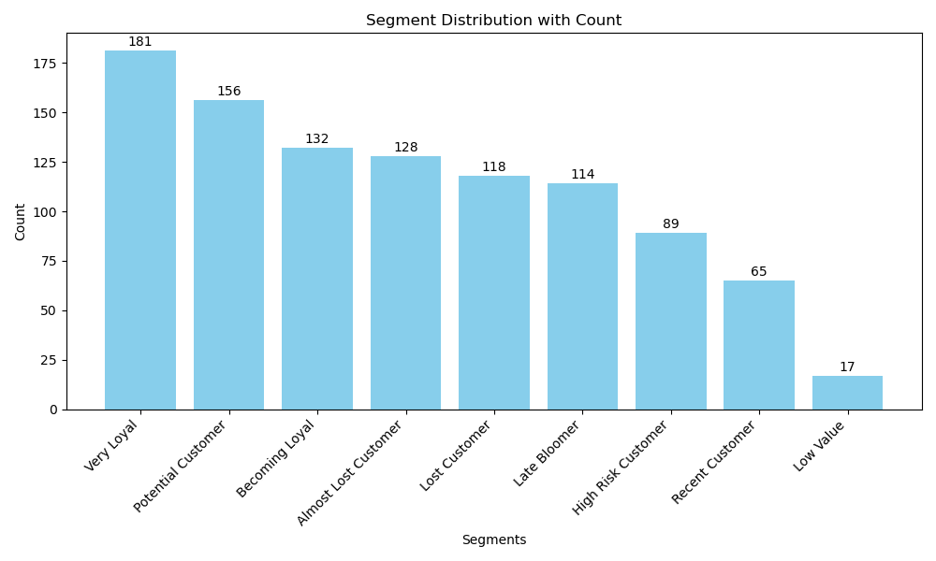
Note: The data and information in this document is reflective of a hypothetical situation and client. This document is to be used for KPMG Virtual Internship purposes only.
Model Development
Customer Segment Distribution
The majority of new customers are likely to be loyal customers.
Highest percent of customers are in ‘Very Loyal’ segment.

Slide 11
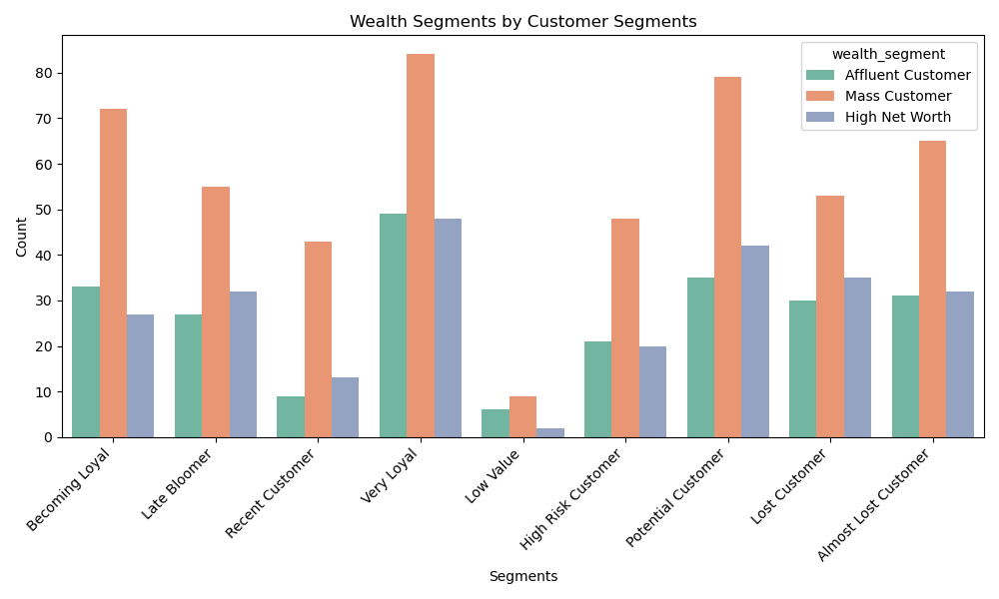
Note: The data and information in this document is reflective of a hypothetical situation and client. This document is to be used for KPMG Virtual Internship purposes only.
Model Development
Wealth Segments by Customer Segments
‘Mass Customer’ group is a majority in all customer segments.
‘Affluent Customer’ and ‘High Net Worth’ groups are nearly even in all customer segments.
Place any supporting images, graphs, data or extra text here.

Slide 12
Note: The data and information in this document is reflective of a hypothetical situation and client. This document is to be used for KPMG Virtual Internship purposes only.
Interpretation
Summary of the segmentation for new 1000 customers
 | Customer Title | Description | Customer Count
1 | Very Loyal | Most recent buy, buys often, most spent | 181
2 | Recent Customer | Most recent, buys often, spends large amount of money | 65
3 | Potential Customer | Bought recently, not very often, average money spent | 156
4 | High Risk Customer | Purchase was long time ago, frewuency is quite high, amount spent is high | 89
5 | Late Bloomer | No purchases recently, but RFM value is larger than average | 114
6 | Becoming Loyal | Relatively recent, bought more than once, spend large amount of money | 132
7 | Almost Lost Customer | Very low recency, low frequency, but high amount spent | 128
8 | Lost Customer | Low RFM | 118
9 | Evasive Customer | Very low recency, very low frequency, small amount spent | 0
10 | Bronze Customer | Very low RFM | 17

